Slide 1
Blood Demand Prediction
AI-Driven Emergency Preparedness System
Healthcare Innovation for Better Resource Management

Slide 2
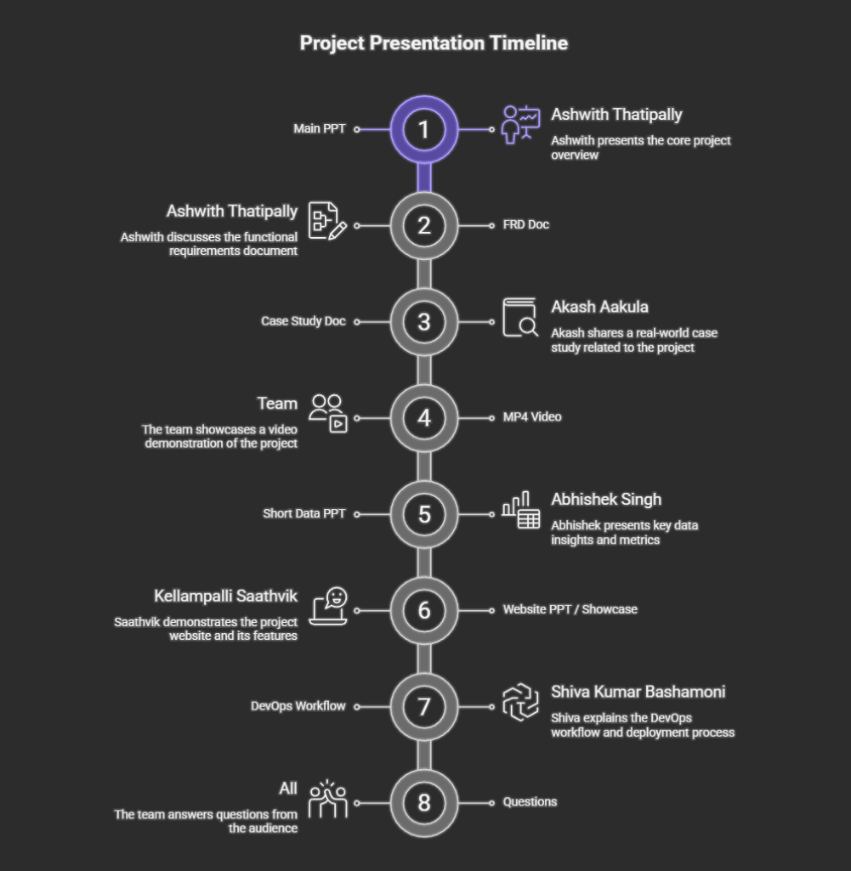

Slide 3
Why This Matters
Blood banks are critical lifelines during emergencies
Sudden spikes occur during accidents, surgeries, disasters
Reactive planning leads to stock-outs and delayed care
AI can shift from reactive to proactive planning

Slide 4
Tools Used
ChatGPT
Perplexity
Notebook LM
Gamma
Napkin AI
PowerPoint

Slide 5
Industry Overview
Current blood bank operations rely on historical averages and manual planning.
Challenge: Delayed response during emergencies
Impact: Frequent stock-outs and high procurement costs
Gap: No predictive capability for demand spikes

Slide 6
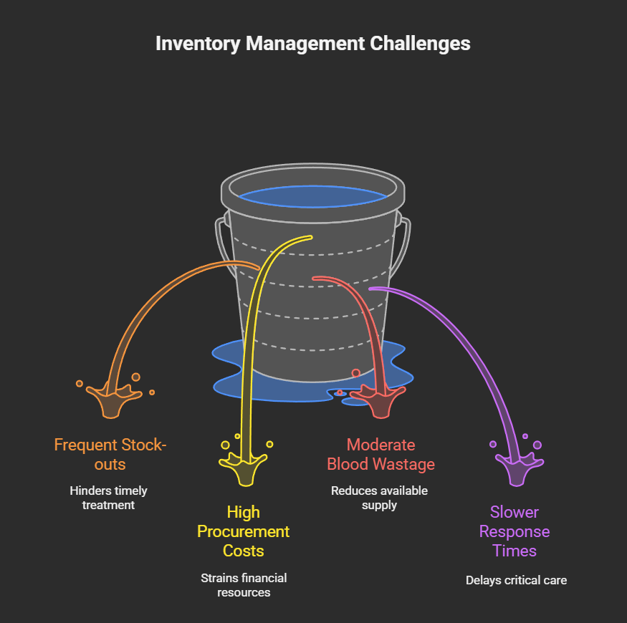

Slide 7
Data Inputs for Prediction
Data Source | Purpose
Historical Blood Usage | Identify consumption trends
Accident Records | Predict emergency demand spikes
Surgery Schedules | Estimate planned blood usage
Seasonal Trends | Account for predictable variations

Slide 8
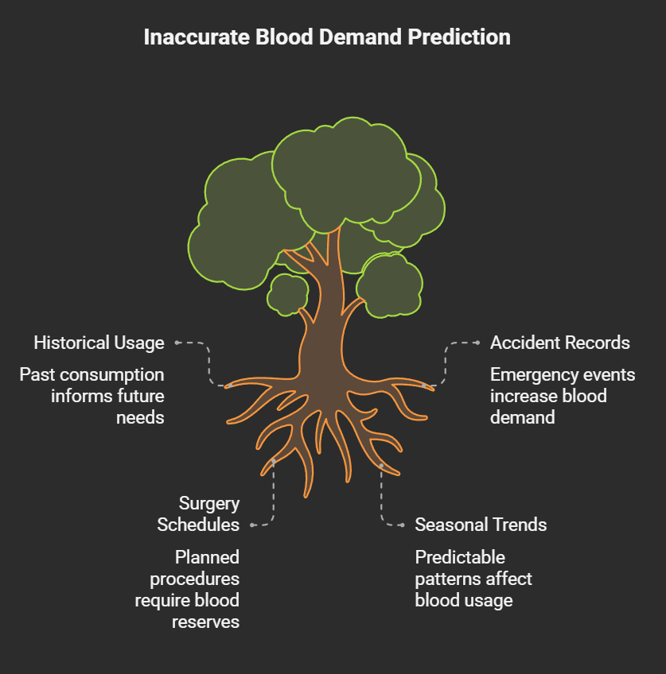

Slide 9
Monthly Blood Demand Trends
Month | O+ | A+ | B+ | AB+ | Total
Jan | 410 | 320 | 290 | 85 | 1,105
Jun | 520 | 410 | 370 | 110 | 1,410
Key insight: O+ has highest demand; demand increases seasonally

Slide 10
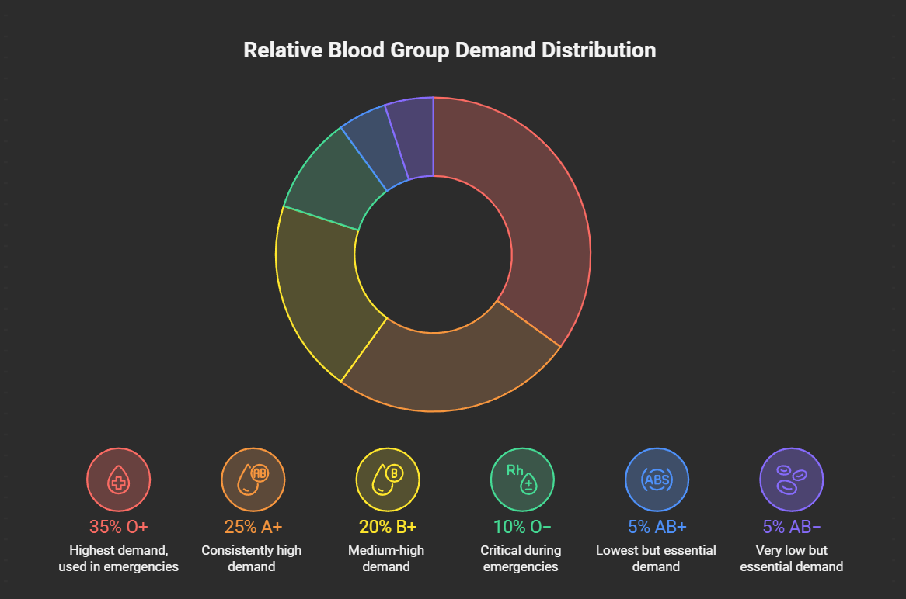

Slide 11
Emergency Demand Spikes
Event Type | Patients | Units Required
Road Accident | 12 | 38 units
Industrial Accident | 18 | 55 units
Natural Disaster | 40 | 120 units
Problem: Cannot handle with average-based planning alone

Slide 12
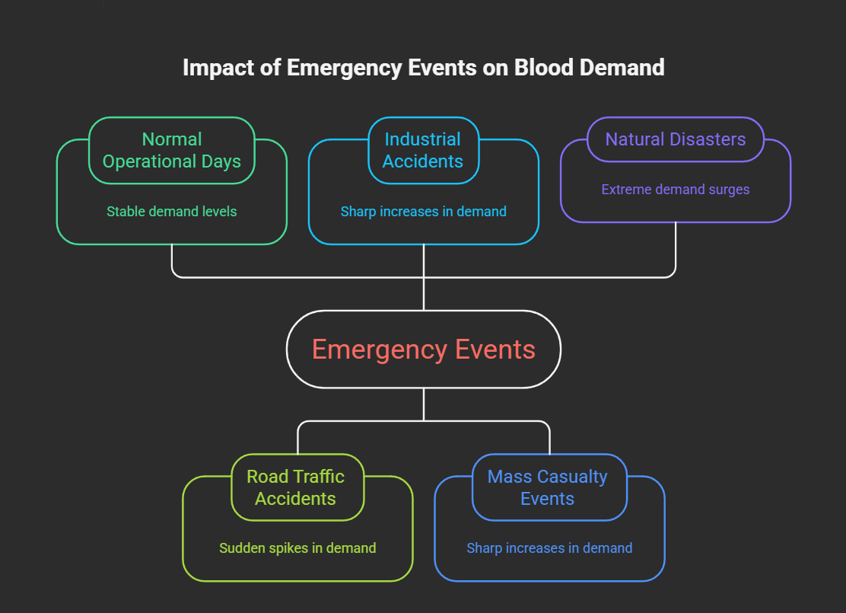

Slide 13
AI Prediction System Design
Input: Historical data, accident records, surgery schedules
Processing: AI model analyzes patterns and trends
Output: Demand forecasts and stock level recommendations
Action: Alerts to blood banks for proactive planning

Slide 14
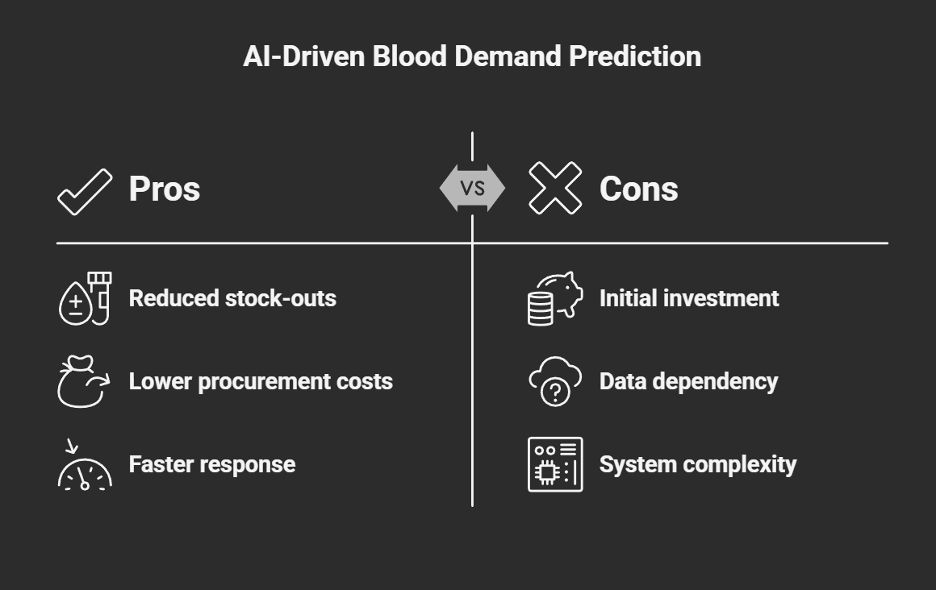

Slide 15
AI Prediction Accuracy
Month | Actual | AI Predicted | Variance
Jan | 1,268 | 1,245 | -23
Apr | 1,452 | 1,470 | +18
Jun | 1,580 | 1,602 | +22
Result: Predictions are close to actual demand

Slide 16
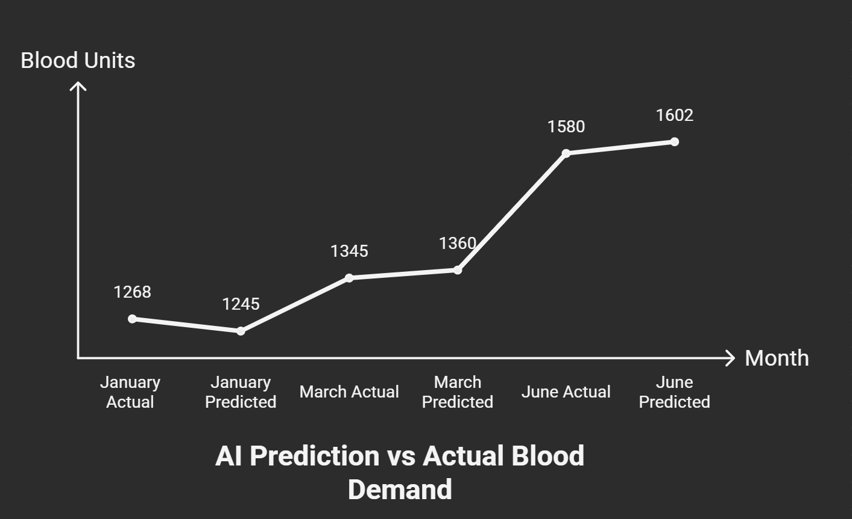

Slide 17
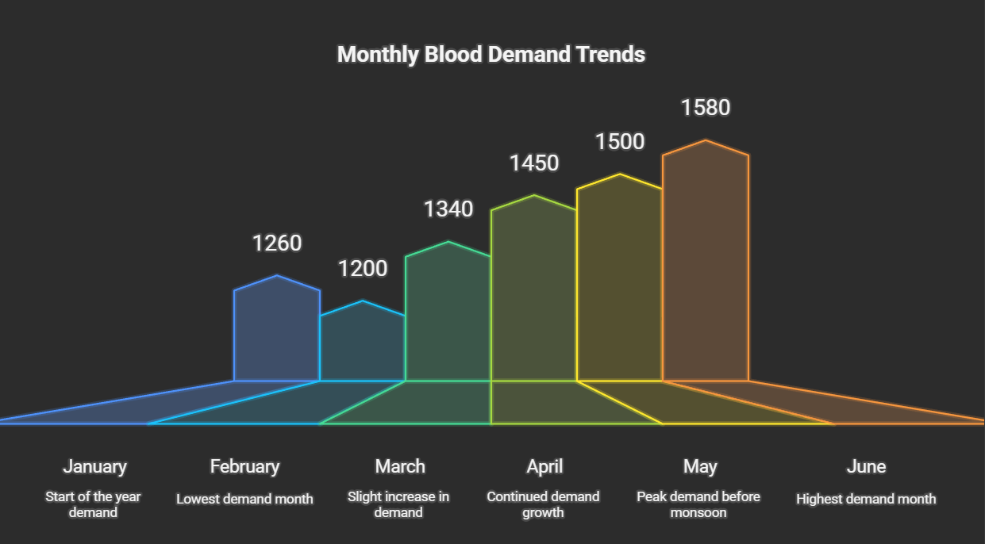

Slide 18
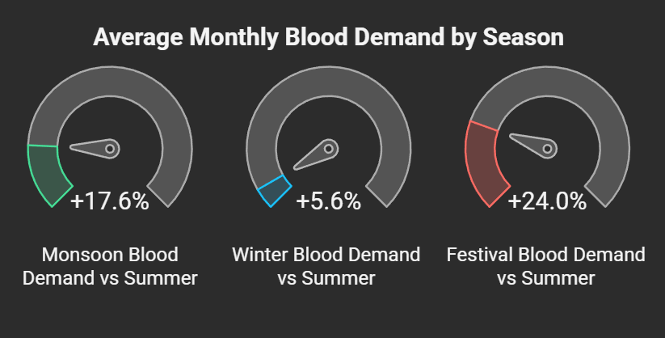

Slide 19
BUSINESS CASE

Slide 20
The Problem & Market Need
Critical Healthcare Challenge
Blood is perishable, life-saving, and cannot be manufactured
Emergencies (accidents, surgeries, disasters) create sudden demand spikes
Current blood bank systems are reactive, manual, and outdated
Key Pain Points
❌ No real-time or predictive demand visibility
❌ Blood shortages during emergencies
❌ Over-stocking leads to high wastage & expiry
❌ Emergency procurement is expensive and slow
❌ Delays directly cost patient lives

Slide 21
The AI-Driven Solution (What We Built)
AI-Driven Blood Demand Prediction System
A decision-support platform for proactive blood inventory planning.
What the System Does
📊 Analyses 5–10 years of historical blood usage
🚑 Integrates emergency & hospital admission patterns
🏥 Considers surgery schedules and hospital demand
📆 Accounts for seasonal & festival trends
🩸 Predicts blood demand by blood group
🔔 Sends early alerts for stock preparation
Key Differentiator
Moves blood banks from reactive crisis management to predictive preparedness

Slide 22
Business Impact & Value Proposition
Operational Impact
✅ Fewer emergency shortages
✅ Faster response during critical situations
✅ Better coordination between hospitals & blood banks
Financial Impact
💰 Reduced emergency procurement costs
📉 Lower blood wastage & expiry losses
📦 Optimised storage & logistics utilisation
Social & Healthcare Impact
❤️ Lives saved through timely blood availability
🏥 Improved patient outcomes
🌍 Stronger public trust in healthcare infrastructure
Strategic Value
Scalable, data-driven healthcare infrastructure with real-world impact

Slide 23
PROJECT CHARTER

Slide 24
Project Vision & Strategic Importance
AI-Driven Blood Demand Prediction System
The Critical Problem
Blood banks operate in high-risk, time-critical environments
Emergencies cause sudden, unpredictable spikes in blood demand
Current systems rely on manual planning & historical averages
Result: Shortages, wastage, higher costs, and risk to patient lives
Our Vision
Shift blood bank operations from reactive to predictive
Enable data-driven emergency preparedness
Support decision-makers with AI-powered demand insights
Strengthen the healthcare emergency response ecosystem

Slide 25
Solution Overview & Value Proposition
What We Are Building
An AI-driven predictive framework that forecasts blood demand during emergencies using:
Historical blood usage data
Emergency and operational patterns
Seasonal and situational demand indicators
Core Capabilities
📊 Predictive blood demand forecasting (by blood group)
📦 Inventory planning recommendations
🚨 Early alerts for emergency preparedness
🏥 Decision support for blood bank officials
Business & Operational Value
✅ Reduced emergency blood shortages
✅ Faster emergency response times
✅ Lower emergency procurement costs
✅ Minimised blood wastage
✅ Improved coordination between hospitals & blood banks

Slide 26
Stakeholder Impact, Feasibility & Success Metrics
Key Stakeholders Benefited
Blood Bank Administrators
Hospitals & Emergency Care Units
Healthcare Policymakers
Patients & the Public Healthcare System
Responsible & Practical Design
Human oversight remains central
Ethical data use & privacy compliance
Gradual adoption with training & phased rollout
Designed within realistic budget and data constraints
Success Metrics
📉 Measurable reduction in emergency shortages
⏱ Improved response times during crises
♻ Reduced blood wastage
👍 Positive feedback from healthcare stakeholders
A scalable, socially impactful solution with strong healthcare relevance

Slide 27
PROJECT VISION

Slide 28
Problem:
Emergency blood shortages due to reactive planning, unpredictable demand, and high wastage.
Vision:
Build a data-driven, predictive blood bank ecosystem that ensures timely blood availability during emergencies, saving lives at scale.
Core Value:
🔮 Predict demand before emergencies happen
📦 Proactive inventory planning
⏱️ Faster emergency response
🩸 Reduced blood wastage
Strategic Impact:
Strengthens healthcare emergency preparedness
Improves hospital–blood bank coordination
Builds trust in public healthcare infrastructure
Success Indicator:
👉 Zero critical shortages, faster response times, and predictive planning as a standard practice.

Slide 29
THIS IS THE LINK FOR THE FULL PROJECT DOCUMENTS
YOU CAN CHECK OUT
BUSINESS CASE
PROJECT CHARTER
PROJECT VISION
FRD DOCUMENT
https://drive.google.com/drive/folders/1HL-MJCntsGnkG7gMM1HOqV06SXyqj5RP

Slide 30
Business Impact: Before vs After
Metric | Before | After
Stock-outs/month | 6 | 2
Procurement Cost | ₹3,50,000 | ₹1,40,000
Blood Wastage | 9% | 4%
Response Time | 3.2 hrs | 1.4 hrs

Slide 31
Cost-Benefit Analysis
Investment: Software, data integration, staff training
Savings: ₹2,10,000/month in emergency procurement costs
Payoff: 2-3 months for ROI at scale
Benefits: Lives saved, better resource utilization

Slide 32
Feasibility Assessment
Technical: Existing AI/ML infrastructure is mature
Operational: Integrates with existing blood bank systems
Ethical: Transparent, supports human decision-making
Outcome: Highly feasible for implementation

Slide 33
Key Takeaways
From Reactive to Proactive: AI-driven prediction enables better planning
Cost Savings: ₹2,10,000/month reduction in emergency costs
Lives Saved: Faster response times, consistent blood availability
Proven Impact: Detailed data shows real operational benefits

Slide 34
Thank You!
Questions & Discussion
AI-Driven Blood Demand Prediction System

